Slide 1






VASANTDADA PATIL PRATISHTHAN’S COLLEGE OF ENGINEERING & VISUAL ARTS
Problem Statement: India - a developing country, one of its kind, has Agriculture and Forestry as its primary sector being one of the biggest contributor to India’s GDP by its one third account, yet is viewed as a tedious and a fatiguing process. Agriculture supplies raw materials to majority of the agro-based industries which in turn helps boost the Indian Economy. The industry yet faces numerous hindrances which prevents it from thriving and making its way to the top, hence being the occupation not chosen by many. This project is aimed to be a comprehensive approach needed to address and tackle the root causes and the immediate needs, engage in creating more awareness, making the occupation more feasible and eliminating unnecessary barriers.
Sector: Agriculture/Rural Development
Domain: Open Innovation
Team Name: VH1
Team Members: Hiral Patel
Vedant Hire

Slide 2


IDEA / APPROACH DETAILS
As discussed in the problem statement, we are majorly trying to make agricultural processes and methods more feasible and hoping to eliminate major part of hindrances that refrains budding generations to taking it up as an occupation and to help already farmers to get better.
Initially it will have a crop planning and management system, where one can choose a crop based on the timeline or the season for the year, out of the given options the user can decide which will be the most suitable for them. Once decided, they can start planning with the irrigation levels, fodder control, composting methods, soil analysis and will be monitored in the crop calendar whether or not the yield is as expected.
Further, the user can also decide if they can maintain two or more crops growing together without interfering with either of their growths, with the options chosen, a proper management schedule can be shown and monitored as well as the resources that goes into it.
While the crop is growing, the user can attend to crop-health analysis as well as farm-food safety questionnaire and get a score of how good the yield is.
The user can read images into the given window to identify which crop it is, and also to perform analysis on whether the unnecessary growing plants are helpful or not.
While accessing for selling options, the user can also make markings on the maps to know which rural roads would need a maintenance check and how bad the quality of the route is.
The user can add their contacts on the main window from where they can get approached for buying the produce or having enquiries.
The user can also include the requirements – labor on their farm sheet with their produce, and enhance rural employment.
VASANTDADA PATIL COLLEGE OF ENGINEERING & VISUAL ARTS | QUASAR

Slide 3
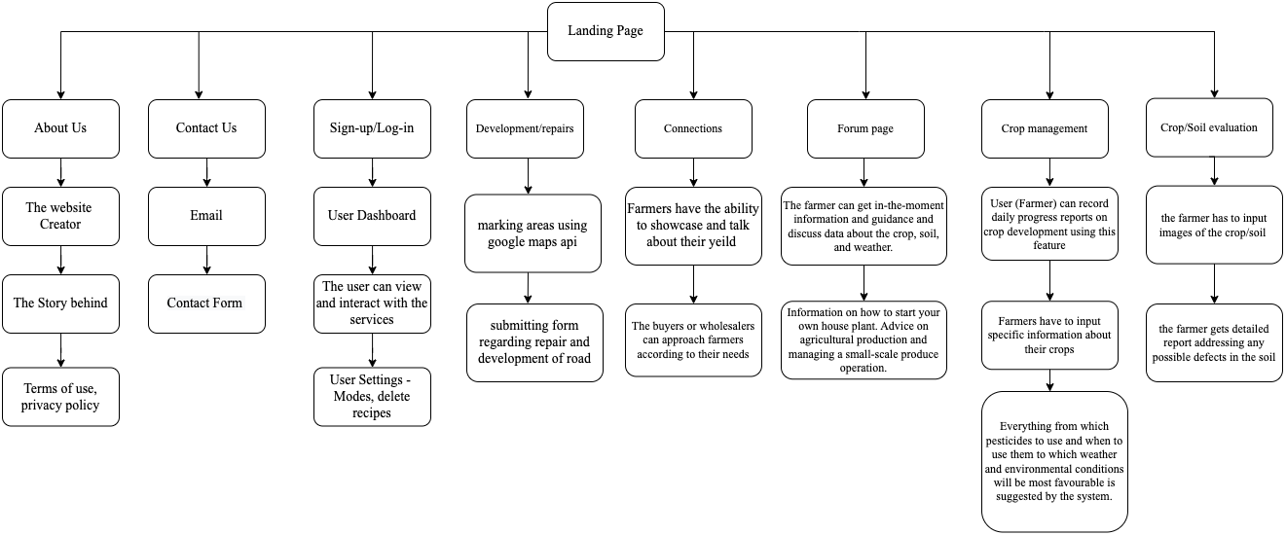
FLOWCHART / ARCHITECTURAL DIAGRAM
VASANTDADA PATIL COLLEGE OF ENGINEERING & VISUAL ARTS | QUASAR

Slide 4
USE CASES
Farmer: They can access the website and use the various management systems available, like the crop planning management system, they can use the weather prediction for time control on the produce, farmers can also get contacts for nearby vendors and wholesalers to sell their produce in the best market price and making most of the profit, and many more features.
Wholesaler/Vendor: The vendor can check the quality and quantity of produce by the farmers nearby, and get in touch with them directly where they can float their details and approach farmers by their preferences.
Budding Farmer: A newbie into the occupation can get access to all the information and knowledge from which crop in which season to all the utilities that go into it, to maintaining timely progress and to check the crop health, or to identify which crop is what.
Potential buyers: They can look into the questionnaires answered by farmers regarding how good their yield is for the season and select one matching their expectations.
Anyone who would want to manage a house-plant: They can learn about composting and small scale produce management and how to maintain plants at home.
Transport Agent: The agent can mark areas on the google maps which will have a distinctive sign which can help the government know which rural roads are in a need of repair.
VASANTDADA PATIL COLLEGE OF ENGINEERING & VISUAL ARTS | QUASAR

Slide 5
TECHNOLOGIES / HARDWARE USED
Frontend: HTML, CSS, Vanilla JS, Bootstrap
Canva, Figma, Draw.io
Backend: Python, Flask, Jinja2
Management System: SQLite
Other Technologies: OpenCV, YOLO, Forest classifiers etc.
(will add more, as and when required.)
VASANTDADA PATIL COLLEGE OF ENGINEERING & VISUAL ARTS | QUASAR

Slide 6
BUSINESS MODEL CANVAS
Our primary demographic consists of agricultural professionals such as farmers and buyers, but it doesn’t just limit itself to that but is inclusive of small scale producers as well as people who just have plants at home. Another aspect of the website will be for rural development and more outreach to the respected individuals who can bring about changes to the much needed and will help generate more rural employment. The website itself is a service and a guide which also creates more awareness about most revenue generating occupation for Indian economy. The core of the business model is the development of a reputable networking platform where farmers and wholesalers can come together and work on ideas of making the produce better and maintaining a better give and take system while eliminating major hindrances faced before. It is a platform to create and promote awareness among the farmers and a platform for them to share their techniques for the enhancement of the community and to encourage new budding farmer professionals. All in all, having technology serve the basic needs required by mankind that is tedious to figure out themselves without having the hassles of operations and calculations to find the perfect proportion for the best produce, and receive the promised gain for it.
VASANTDADA PATIL COLLEGE OF ENGINEERING & VISUAL ARTS | QUASAR

